Slide 1
Identifying High-Risk Covid-19 Cases for Intensive Care
George Mason University
Fairfax, VA
SYST 573/OR 681 – Decision and Risk Analysis
Fall 2020
Team : Deepthi Tamma

Slide 2
Problem Background & Decision
The United States is currently experiencing a surge of Covid-19 cases
Hospital administrators must make the decision of who is prioritized for care in ICU beds
Our system will look at proactively identifying high-risk patients so that the loads on ICU facilities is reduced
Decision Maker for this system would be governmental health administrations & hospitals (such as the Virginia Department of Health)
System will be evaluated using 10 test cases
Decision: Which patients are at high risk for a severe case of Covid-19?

Slide 3
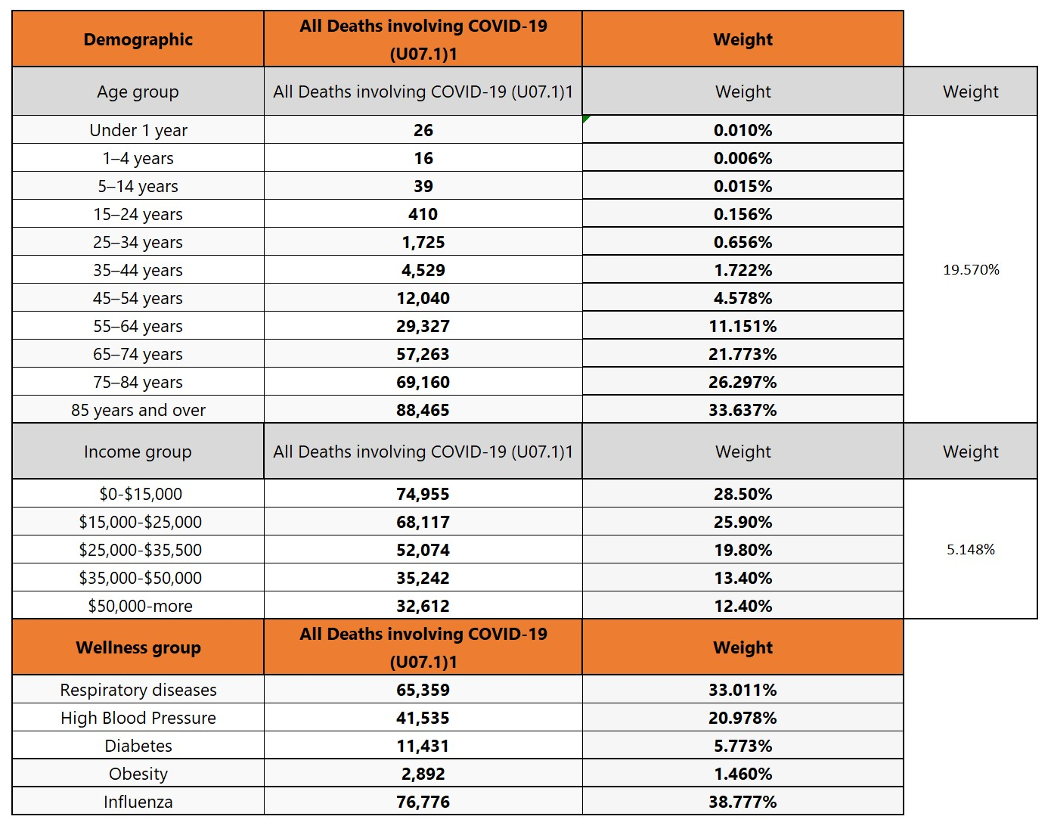
Research Conducted to Inform the Decision
The table explains about the weights associated with deaths involving Covid-19 for Demographics and wellness Group.
Assumption: percentage of deaths correspond to the probability of death depending on that attribute.
We found that ethnicity and gender were not good sub-objectives.
As a result, two other attributes have been chosen, income and influenza
Based on the data, we chose to use linear single dimensional value functions

Slide 4
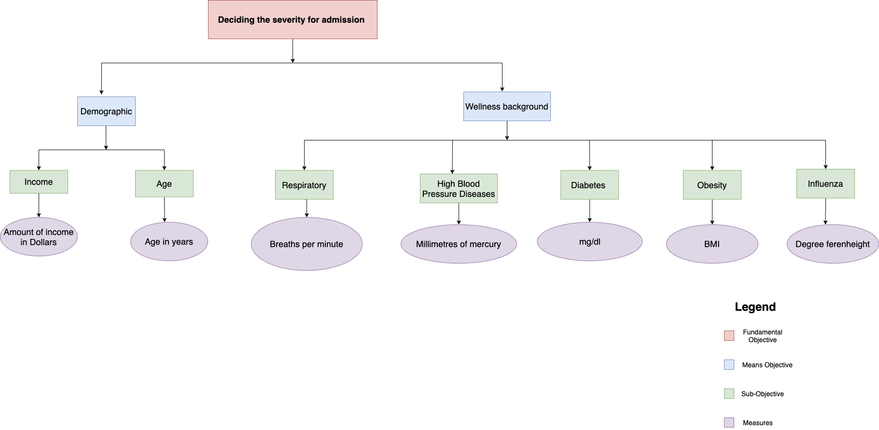
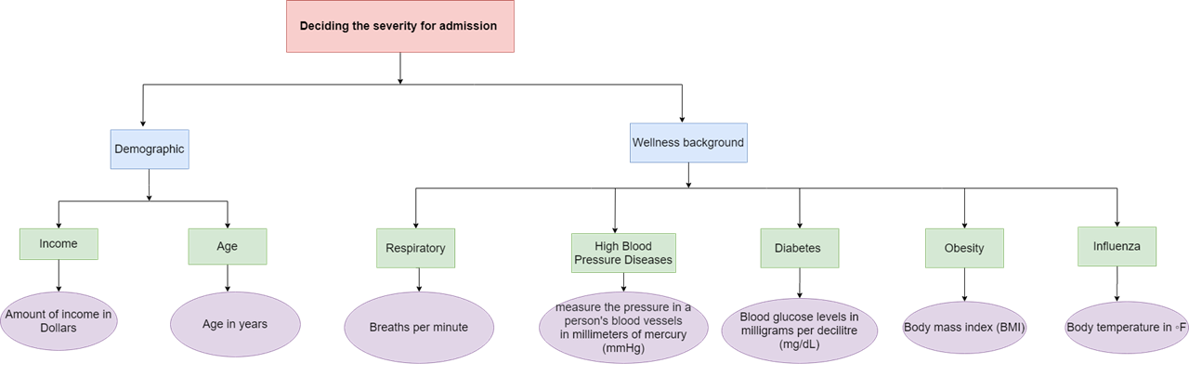
Value Hierarchy
3 levels of hierarchy: Fundamental Objective, Means Objective, Sub Objective, Measures.
Fundamental Objective: is deciding the severity for admitting the patient in the Intensive care unit.
Means objectives: Demographic and Wellness Background which are further classified into Income, Age, Respiratory, High Blood Pressure Disease, Diabetes, Obesity and Influenza.
The objectives have individual measures to calculate the survival rate through which a decision to categorise the patient to critical unit or normal care is decided.

Slide 5
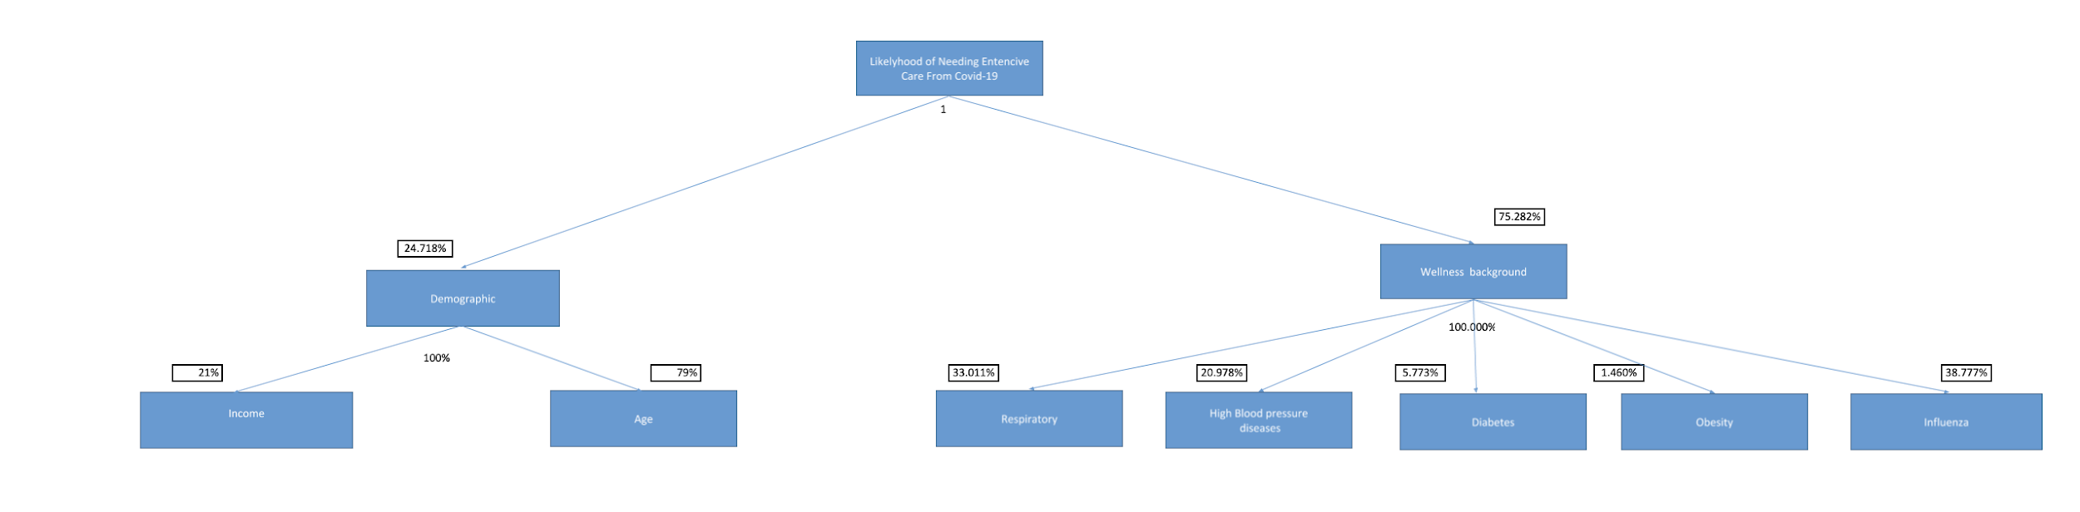
Decision Tree
Understand weights to see the importance of each attribute that contributes towards making the decision
Wellness background is more impactful than Demographics
Among Demographics, Age is the most important.
Influenza plays the most impactful part in wellness background while Obesity the least

Slide 6
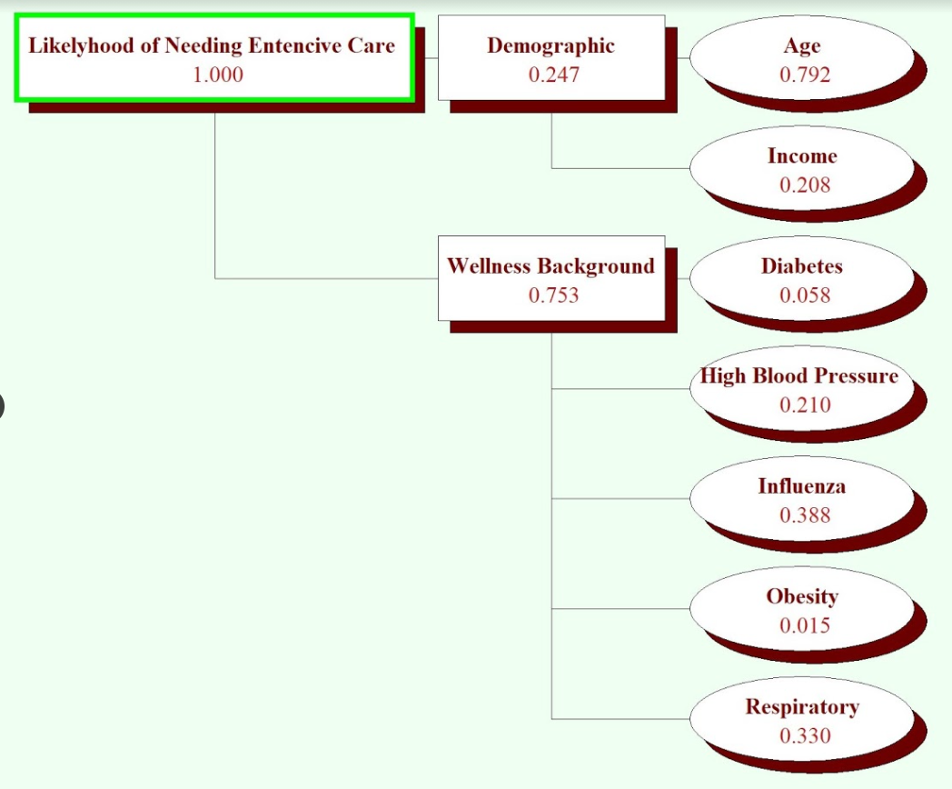
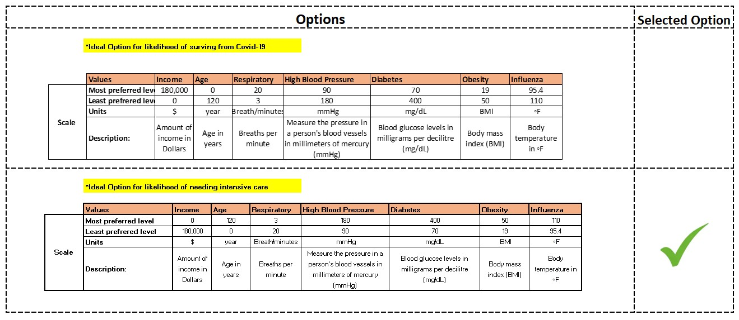
Logical Decisions for Windows
LDW was used to better map the behavior of our system, and also the importance of each attributes from the bottom row of our VH.
The appropriate weights were assigned based on data collected from CDC’s website.
A scale value was assigned to each attributes using the format below.
Most Prefered level
Least Preferred level

Slide 7
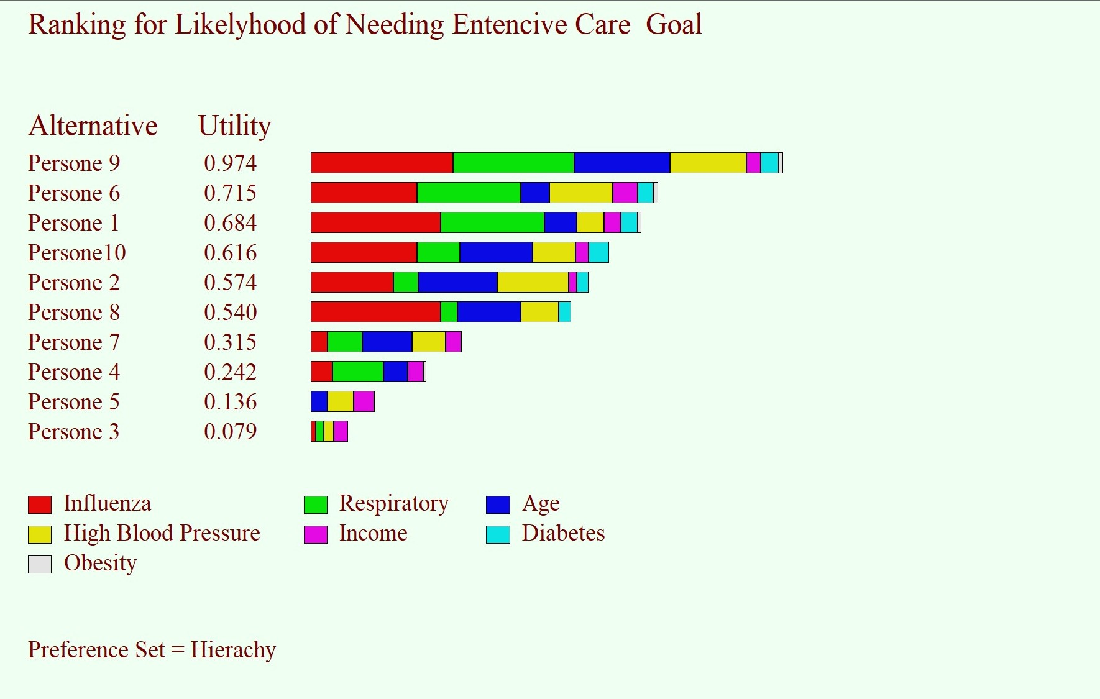
Logical Decisions for Windows
Our ranking measures shows that Influenza and respiratory disease had the most impact on deciding the likelihood of a person with covid-19 needing intensive care or not.
From studying our ranking graph we can determine that person-9 is more at risk from dying due to covid-19, followed by person 6,1,10,2,8.
Person 7,4,5,3 scores the lowest which means that even though they’re all at risk from dying due to covid-19, but this group has a higher chance of surviving when compared against person 9,6,1,10,2, and 8.

Slide 8
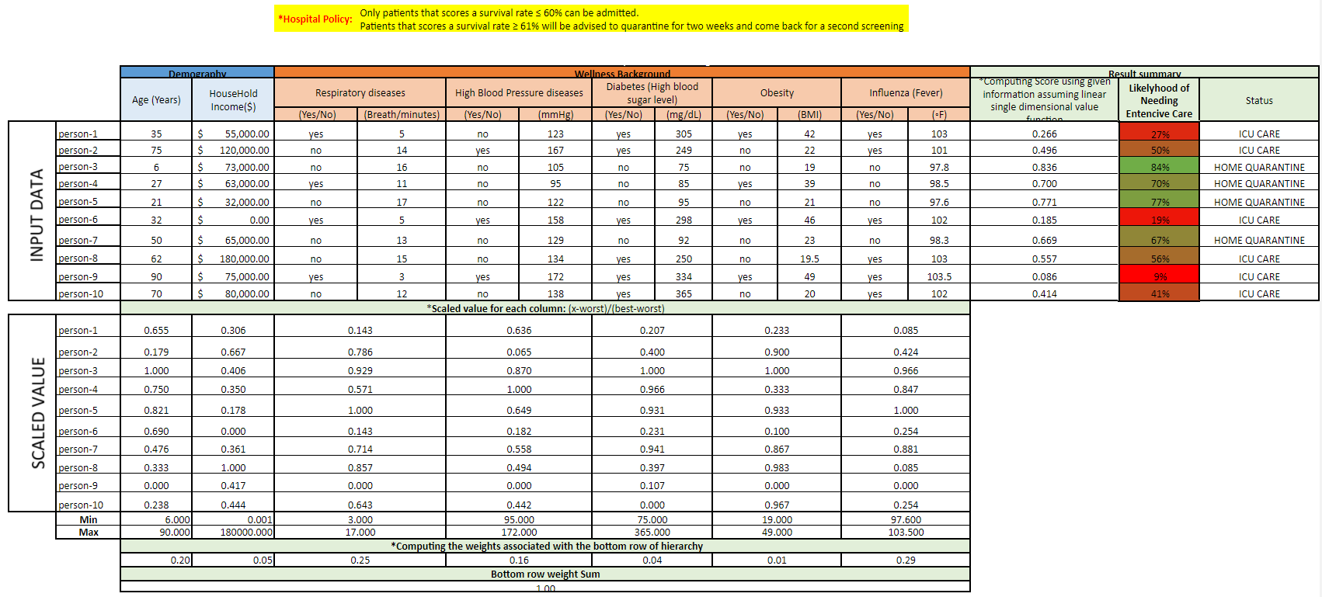
Decision Model

Slide 9
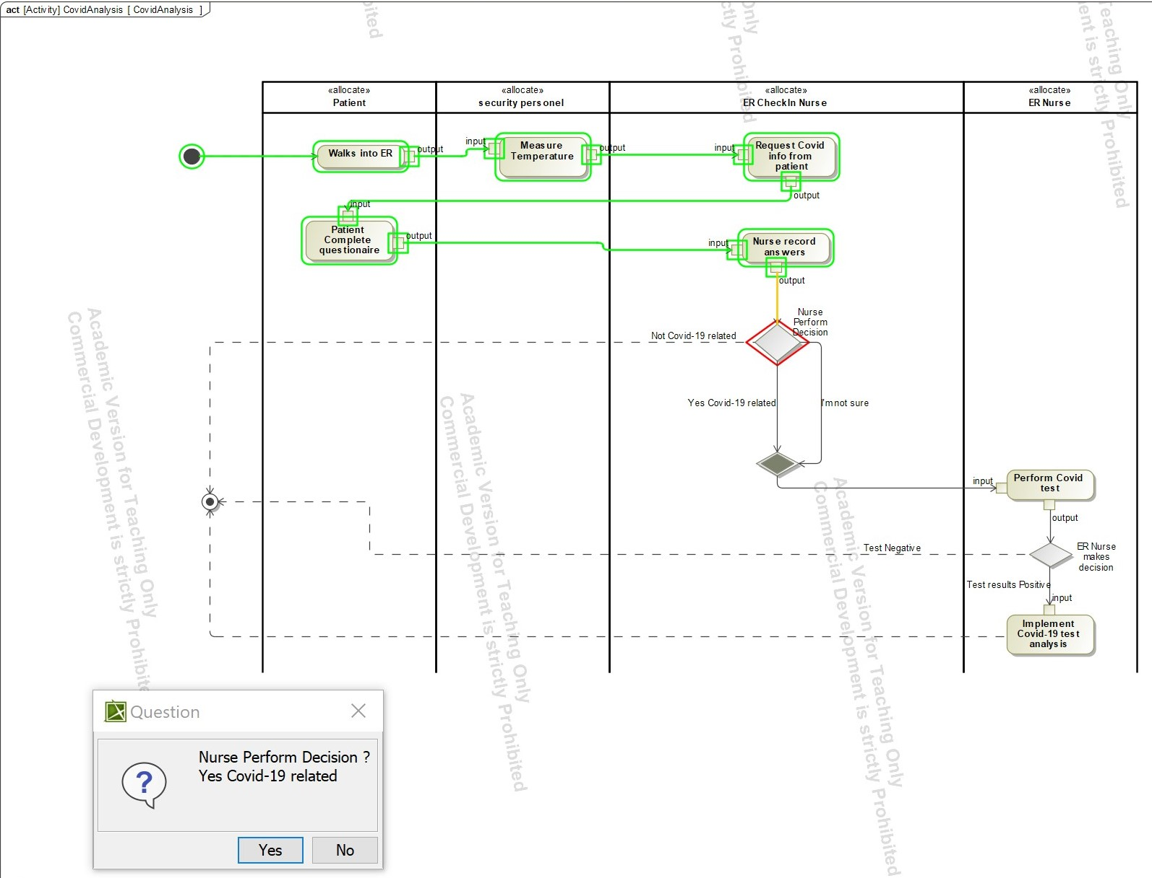
System Implementation
Step 1: Patient walks into the ER
Step 2: ER Nurse measures patient’s temperature
Step 3: Patient states the reason for visit
Outcome A: Covid-19-related, move to Step 4
Outcome B: Not Covid-19 related, system cannot be applied
Step 4: ER Nurse perform Covid-19 test
Outcome A: Test positive, move to step 5
Outcome B: Test negative, system cannot be applied
Step 5: ER Nurse implements the system

Slide 10
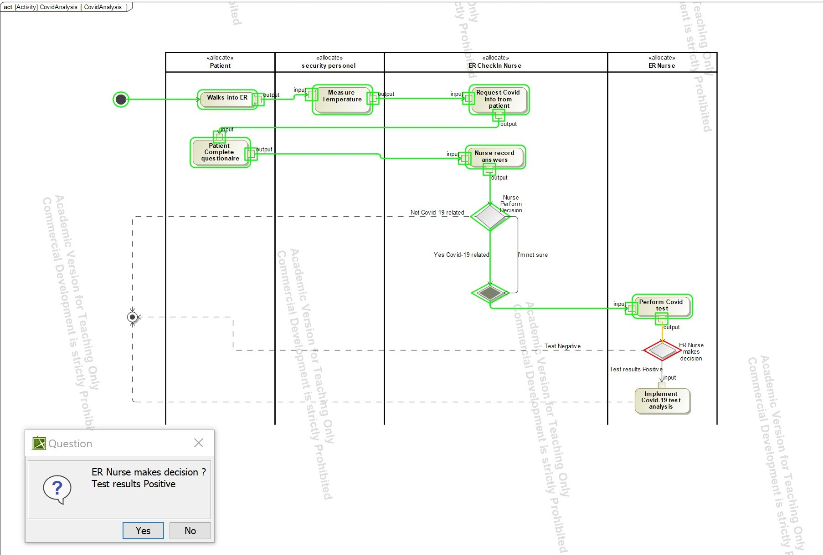
System Implementation
Step 1: Patient walks into the ER
Step 2: ER Nurse measures patient’s temperature
Step 3: Patient states the reason for visit
Outcome A: Covid-19-related, move to Step 4
Outcome B: Not Covid-19 related, system cannot be applied
Step 4: ER Nurse perform Covid-19 test
Outcome A: Test positive, move to step 5
Outcome B: Test negative, system cannot be applied
Step 5: ER Nurse implements the system

Slide 11
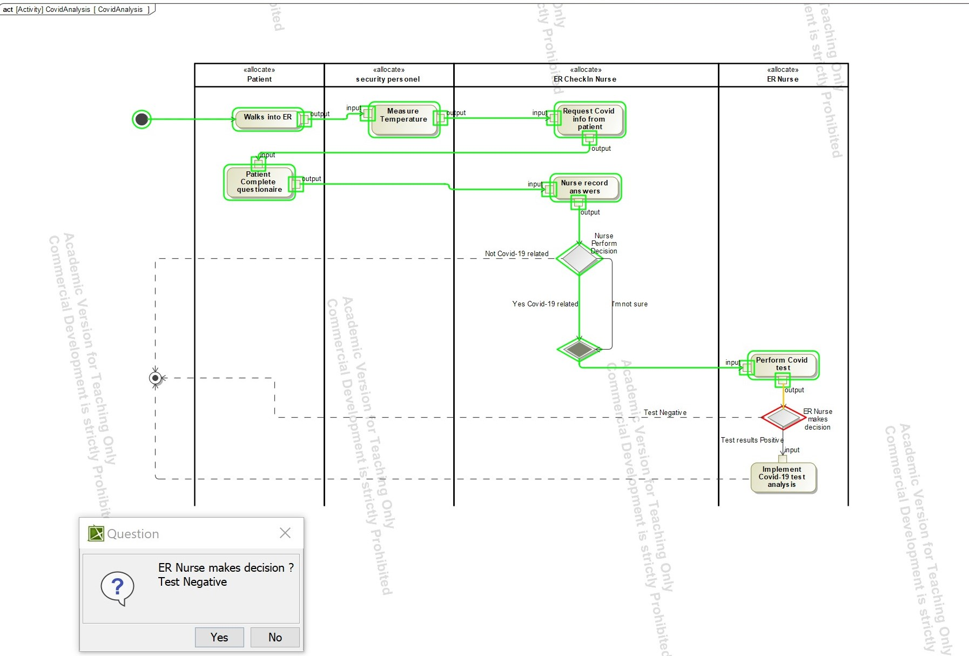
System Implementation
Step 1: Patient walks into the ER
Step 2: ER Nurse measures patient’s temperature
Step 3: Patient states the reason for visit
Outcome A: Covid-19-related, move to Step 4
Outcome B: Not Covid-19 related, system cannot be applied
Step 4: ER Nurse perform Covid-19 test
Outcome A: Test positive, move to step 5
Outcome B: Test negative, system cannot be applied
Step 5: ER Nurse implements the system

Slide 12
Conclusion
Decided on factors impacting decision and developed by adding and removing depending on the decision maker
Built a form which contains all the attributes that decides on the severity of the patient
Overall score is called the Survival rate and the patients with scores less than 60 need to be admitted to the hospital immediately and with score greater than 60 are most likely are in less danger and can be quarantined for a few days and come back for second screening
Our results further emphasized our success rate because the decisions that we made for the test cases made sense to the Decision Maker and ourselves

